Slide 1
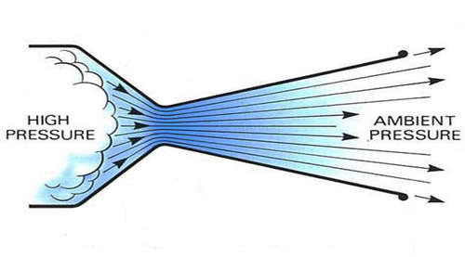
CFD Analysis of a Super Sonic Nozzle
By Max Plomer

Slide 2
Problem Specification
Air flows at a high speed through a circular cross-section, custom designed converging-diverging nozzle
Air at inlet is atmospheric: 101,325 Pa and 300K
Outlet conditions are 3000 Pa and 300K
Large Reynolds number, viscous effects will be small, therefore flow modeled as invicid

Slide 3
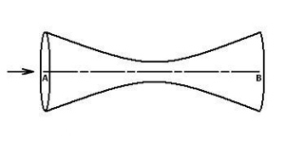
Initial Arbitrary Nozzle Design
r = 0.1m
r = 0.15m
L = 0.5 m
Need an equation for the line of form: Y= A*X² + B
With points (0 , 0.1) and (0.25 , 0.15)
Therefore: Y= 0.8*X² + 0.1
Increase the outlet radius up until r = 0.3m to see how the mach number at the wall and axis is affected.

Slide 4
Why Varying Outlet Area?
Rocket engines use a converging-diverging nozzle, and an increase in the area of the outlet gives a higher mach # at the exit, but limits the range of back pressures that the rocket can operate.
With a correct integration of the chemistry for methane or hydrogen, an engineer can design their rocket to be most efficient for all the back pressures of the application.

Slide 5
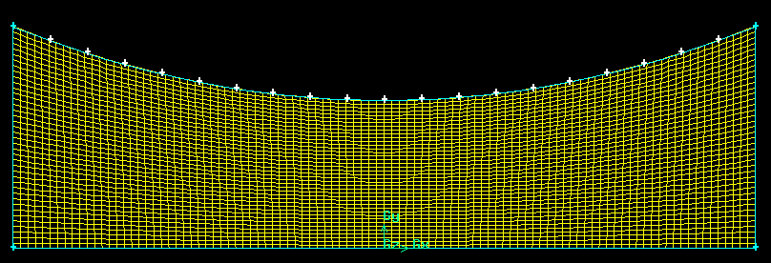
2-D Mesh
Since Axi-symmetric, modeled top half only
Used a 40x100 mesh
Set boundary types as: Pressure-inlet, Pressure-outlet, Wall & Axis

Slide 6
Fluent Physics Options
Solver: Since we have a high-speed compressible flow, using the density-based solver
Space: Solve the axi-symmetric form of the governing equations
Viscous Model: Inviscid, solver will neglect viscous terms
Using Energy Equation, because since a compressible flow, energy equation will be coupled to continuity and momentum equations
Density of Air: Ideal gas
Pressure inlet: 101,325 Pa @ 300K, Pressure outlet: 3,000 Pa@300K
Solution Methods: Second Order Upwind
Convergence criteria for : 1*10⁻⁶
600 Iterations

Slide 7
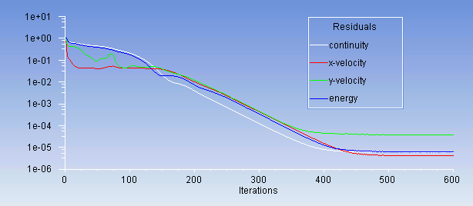
Convergence
For the given mesh & parameters simulation converges at around 500 iterations

Slide 8
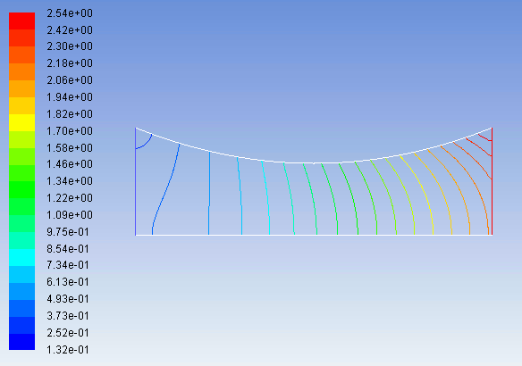
Results – Velocity Contour (Mach #)
Notice: velocity greater at wall for diverging section

Slide 9
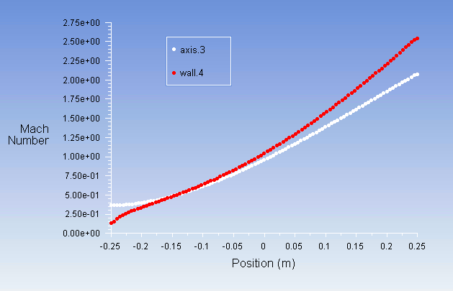
Results – Velocity X-Y Plot
Axis reaches mach 2.05, while Wall reaches mach 2.55

Slide 10
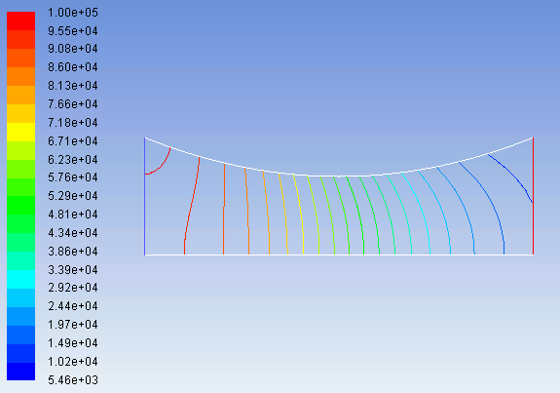
Results – Static Pressure (Pa)
Notice that pressure decreases from left to right

Slide 11
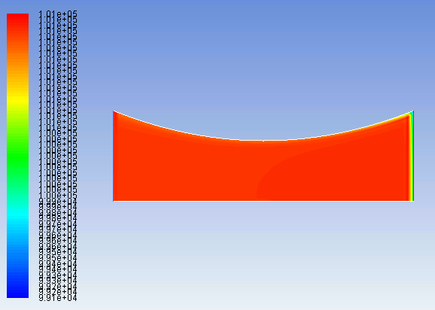
Results – Total Pressure
Notice pressure loss at outlet, due to false diffusion

Slide 12
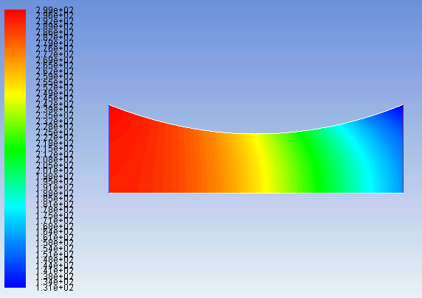
Results – Static Temperature (K)

Slide 13
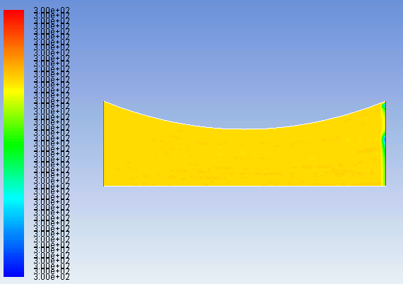
Results – Total Temperature (K)
Notice the constant total Temp of 300K, and round off error near the outlet

Slide 14
Varying of Outlet Radius, to see effect on Mach #
Running simulations for R_{outlet} = 0.15m, 0.20m, 0.25m & 0.30m, with all other parameters the same.
Equation for points left of origin still Y= 0.8*X² + 0.1
For right of origin equations are:
0.15m: Y= 0.8*X² + 0.1
0.20m: Y= 1.6*X² + 0.1
0.25m: Y= 2.4*X² + 0.1
0.30m: Y= 3.2*X² + 0.1

Slide 15
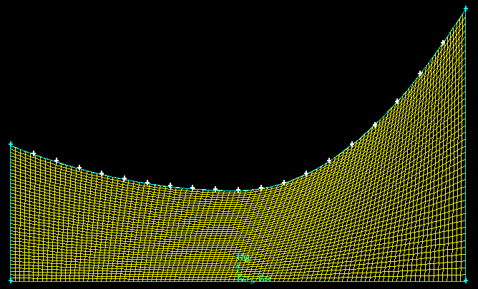
Mesh for R_{outlet} = 0.30m

Slide 16
Values of R_{outlet} vs Mach # of Axis & Wall
R_{outlet} =.15m
Axis: mach 2.05, Wall: mach 2.55
R_{outlet} =.20m
Axis: mach 2.3, Wall: mach 3.55
R_{outlet} =.25m
Axis: mach 2.5, Wall: mach 4.45
R_{outlet} =.30m
Axis: mach 2.55, Wall: mach 5.25

Slide 17
Graph of R_{outlet} vs Mach # of Axis & Wall
Wall
Axis

Slide 18
Conclusions
For the given geometry, we see a linear relationship between mach # & outlet radius at the wall, but the increase in axis mach number diminishes as the outlet radius increases.
Should try different nozzle shapes to see if higher mach numbers for a given expansion ratio can be achieved, possibly convex, or a mix of concave(current shape) and convex
Could also do a study of the range of acceptable back pressures for the different nozzle geometries

